Slide 1
NODE.JS
(The Backend Of MERN Stack)
Lecture 1

Slide 2
Today’s Agenda
Prerequisites Of The Course
What Is Node.js ?
Node.js V/S Browsers
What Node.js Can Do ?
When To Use And When Not To Use Node.js ?
History Of Node.js

Slide 3
PRE-REQUISITES
This course is all about using JS related technologies at the backend of a web application.
So you must be familiar with:
Modern JavaScript ( Specially features like callback , arrow functions , promise etc)
HTML
CSS

Slide 4
What Is Node.js?
Node.js isn’t a programming language or a framework
Node.js is an open-source , cross-platform JavaScript runtime environment, built upon Chrome’s V8 engine.
Let’s break down the above definition into 4 parts:
Open Source
Cross Platform
Chrome’s V8 engine
JavaScript Runtime Environment

Slide 5
What Is Node.js?
Open Source: Means source code of Node.js is publicly available for sharing and modification
Cross Platform: Means it is available on Mac, Windows and Linux
Chrome’s V8 Engine: This is a software that translates our JavaScript source code into machine understandable code that allows a computer to perform specific tasks.
Java Script RunTime Environment: This is a bit lengthy , so lets discuss it in full detail

Slide 6
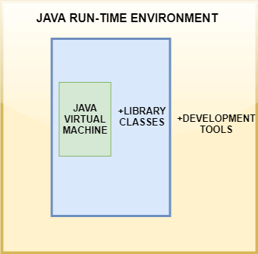
What Is A Run Time ENVIRONMENT?
A RunTime Environment is a software that provides all the components required to run some code.
In simple words , it is a container that executes the code.
A JavaRuntime Environment is responsible for providing all the components needed to run a Java Program

Slide 7
What Is Java Script Run Time ENVIRONMENT?
A JavaScript runtime environment is a software that provides access to built-in libraries and objects that are available to a JS program so that it can interact with the outside world and make the code work.

Slide 8
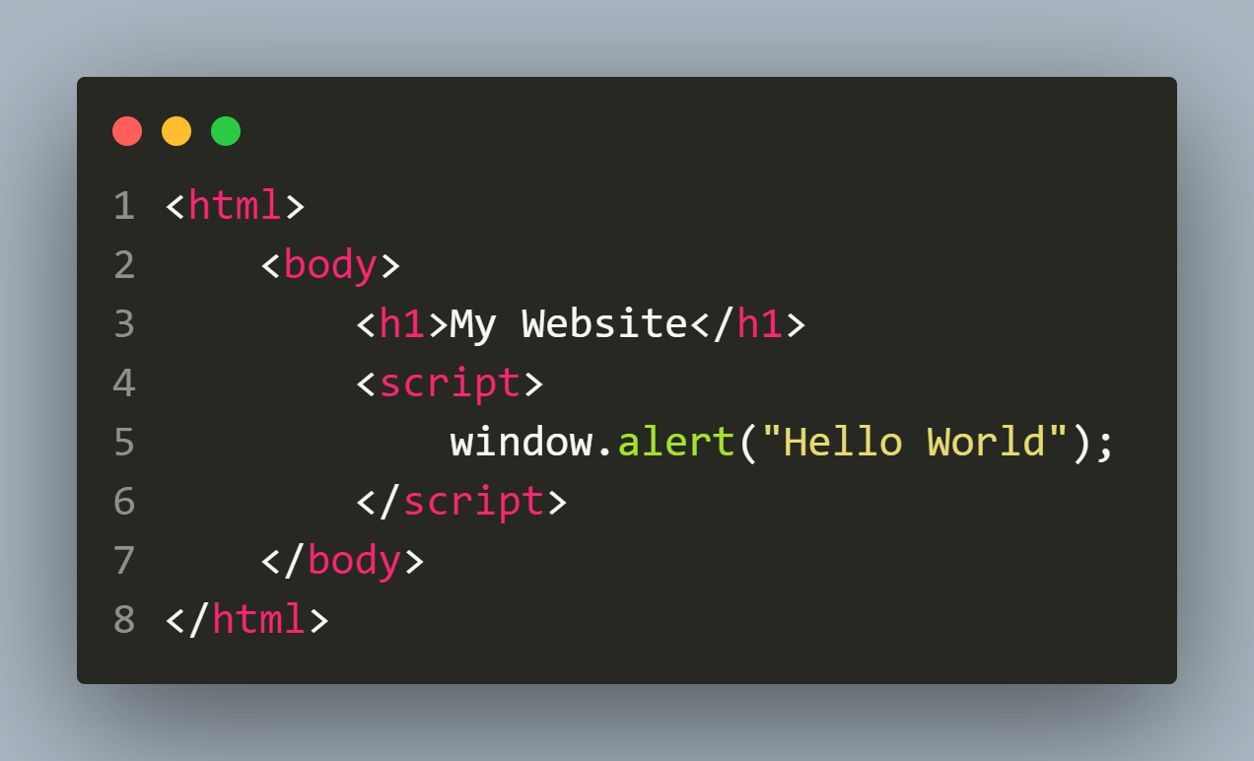
example
The above code will show a pop up box generated by window.alert() .
Can you guess from where window.alert() came ?
The answer is that we are executing this code in the browser’s runtime environment.
The window.alert() method is built into this environment and any program executed in a browser has access to this method

Slide 9
Another Example
How do you fetch an element using its id in JS ?
We can fetch an element by its id using a DOM method called document.getElementById()
Support for this document object is provided by JavaScript runtime environment provided by the web browser.

Slide 10
browser’s run time environment
The browser's JS RunTime is comprised of 4 major elements:
The JavaScript engine (which in turn is made up of the heap and the call stack)
Web APIs
The callback queue
The event loop

Slide 11
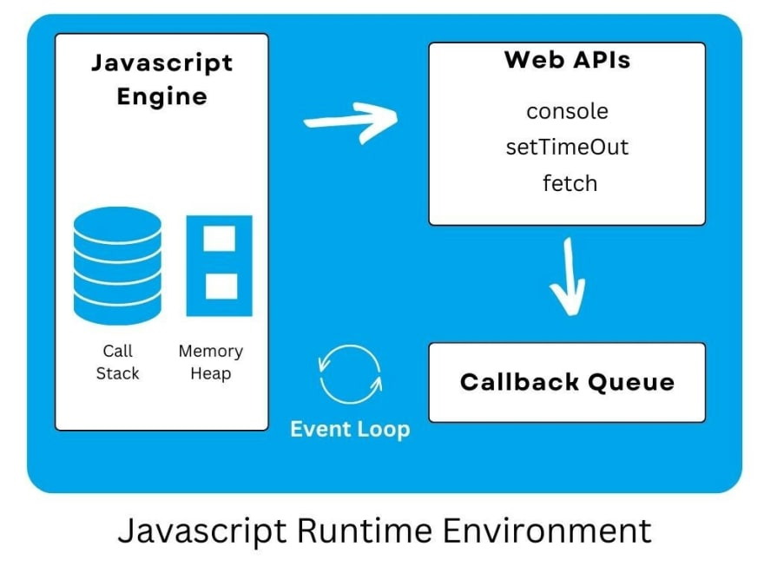
browser’s run time environment

Slide 12
Three popular js runtime environments
The three popular JavaScript RunTime Environments are:
the runtime environment of a browser (like Chrome, or Firefox)
the Node.js runtime environment
the Service worker runtime environment

Slide 13
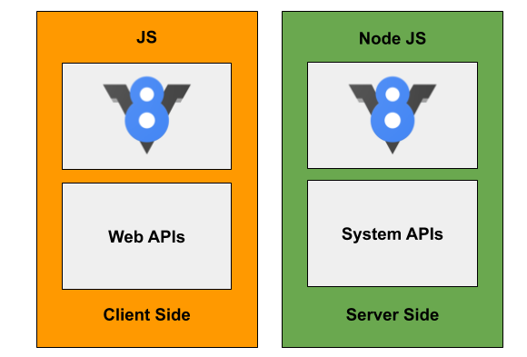
Chrome’s runtime & node js runtime

Slide 14
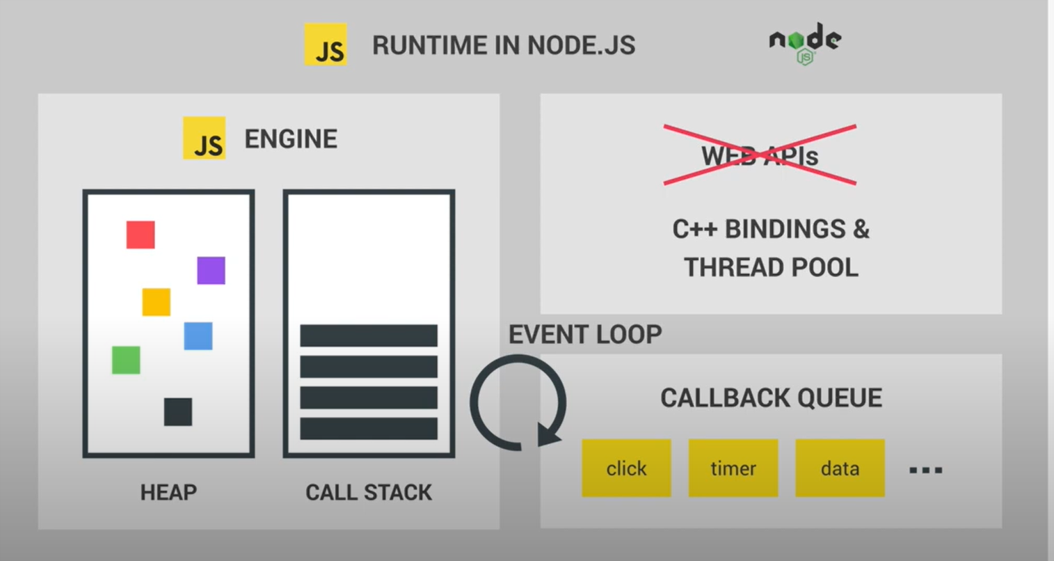
The bigger picture

Slide 15
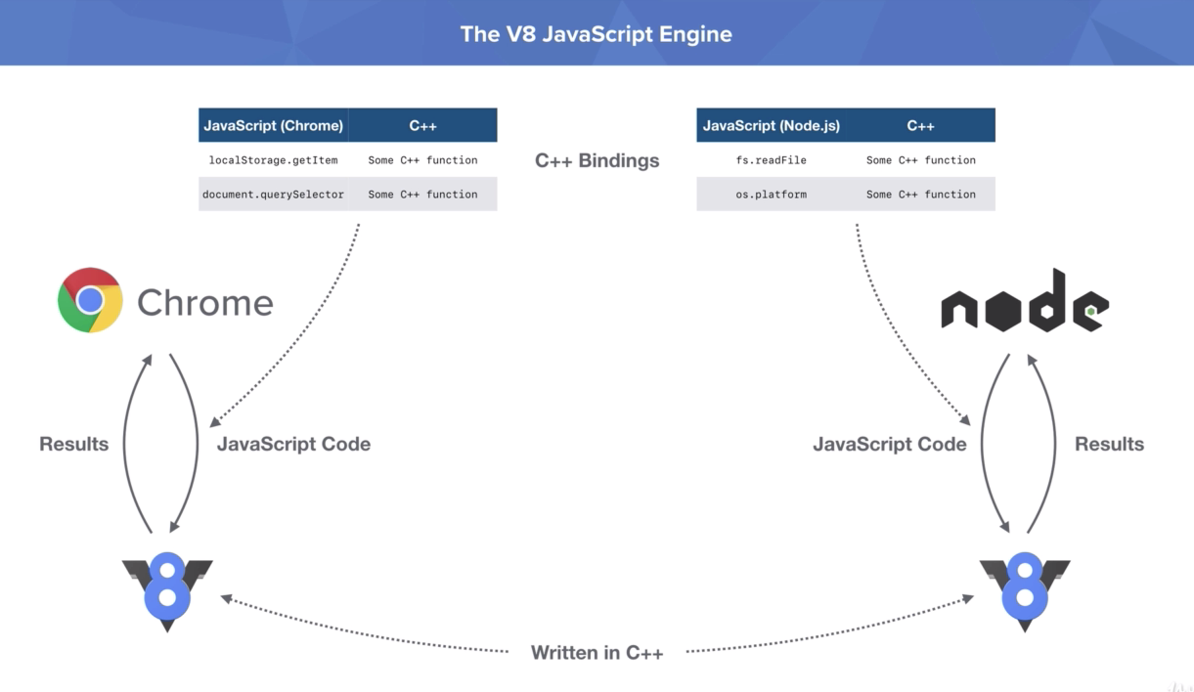
How node js works at the server side ?

Slide 16
How node js works at the server side ?
Node.js passes the JavaScript code to V8 engine , the V8 engine processes the code and sends the result to Node.js
Along with the JS Code , the Node.js run time also passes something called C++ bindings to the V8 engine.

Slide 17
How node js works at the server side ?
Bindings are series of methods that can be used in Node.js code which are in reality just running C++ code behind the scenes.
For example:
fs.readFile()
This method is not a part of JavaScript.
It's provided to V8 as part of the Node.js runtime.

Slide 18
How node js works at the server side ?
So JavaScript does not know how to read a file from disk but C++ does.
So when we use JavaScript code and Node.js to read a file from disk it just defers all of that to the C++ function that can actually read the file from disk and get the results back.

Slide 19
Very important question!
Are Node.js and browser both the same thing?
(As both of them provide the platform(JS engine) to execute the JavaScript code.)
Answer is NO.
Here are some key differences between them.

Slide 20
Node.js V/S Browser
Browser’s Env | Node JS Env
Executes JS Code inside the browser at the client end | Executes JS Code inside the server
Mainly used for UI based event handling and DOM Manipulation | Mainly used for performing tasks like File handling , Database interaction , creating web servers/api etc
Makes extensive use of window and document object | No window object present , rather we have an object called global as well as another object called process
No support to access OS functionality | Allows us to access OS functionality like name , architecture , total memory , free memory etc

Slide 21
Benefits of node.JS
Easy—Node.js is quite easy to start with and is a go-to choice for web development beginners.
Maintainable—Node.js is an easy choice for developers since both the frontend and backend can be managed with JavaScript as a single language
Packages—A vast set of open-source packages is available for Node.js that can simplify our work. There are more than one million packages in the NPM ecosystem today.
Speed—Non-blocking thread execution makes Node.js even faster and more efficient.

Slide 22
What node.js can do ?
Create, open, read, write, delete, and close files on the server
Add, delete, change data in our database
Collect form data
Generate dynamic page content

Slide 23
Where is node.js used ?
Node.js– is BEST CHOICE for:
Backend for social media networking
Single-page application
Chat application
Data streaming
IoT application

Slide 24
Where node.js shouldn’t be used ?
We have looked at many popular Node.js benefits so far, but there are a few cases where we shouldn’t consider it.
If you are building any of the following applications, then DO NOT USE Node.js :
CPU intensive computations
Heavy server-side processing

Slide 25
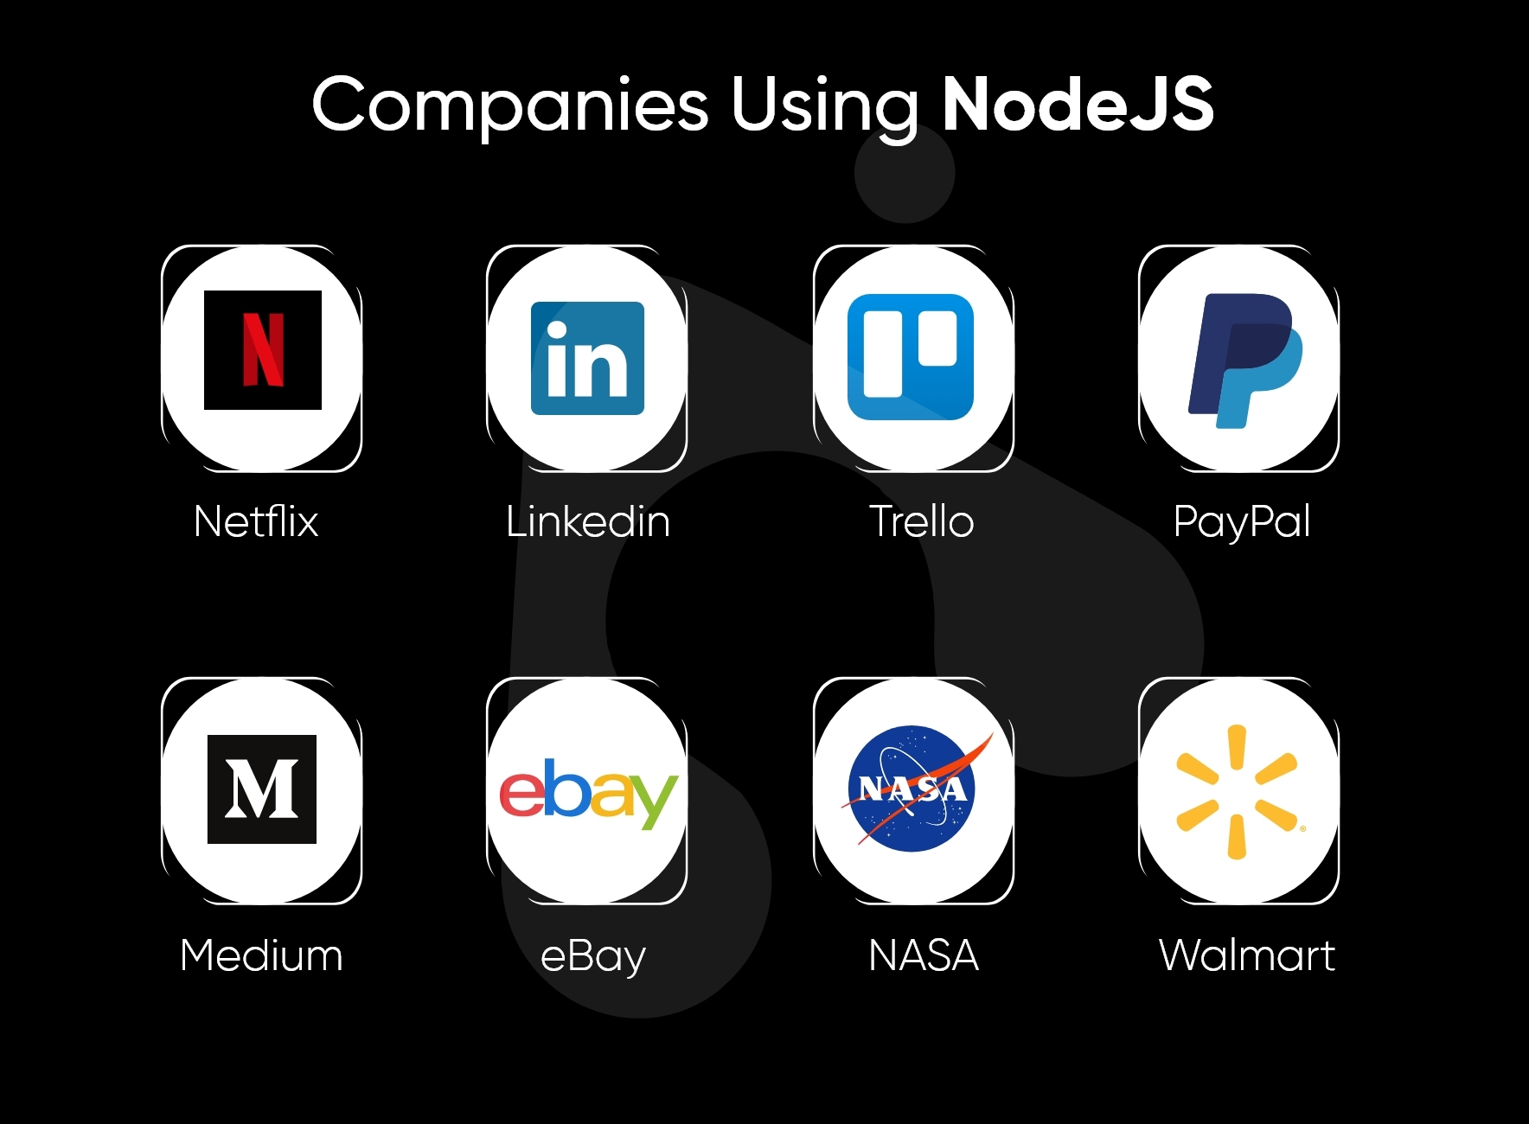
Top companies using node.js

Slide 26
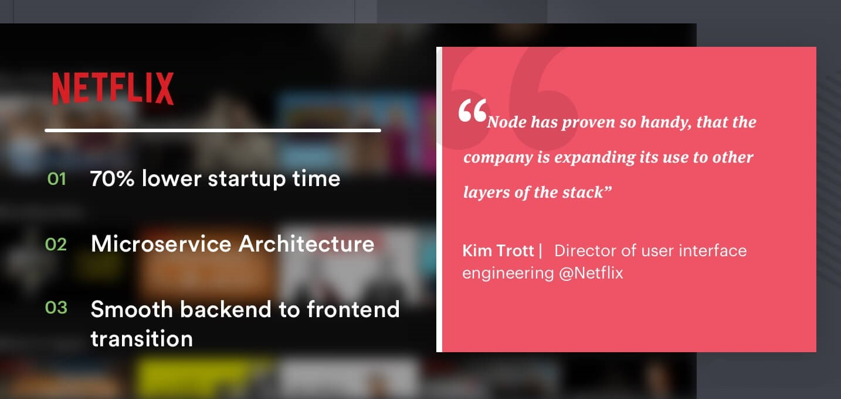
What netflix says ?

Slide 27
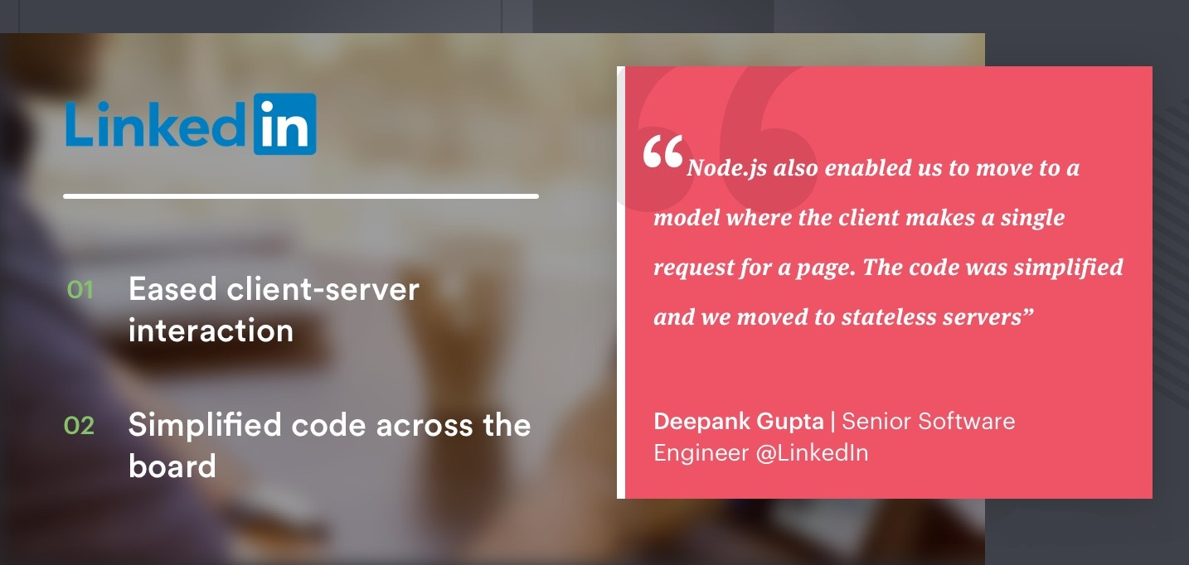
What linkedin says ?

Slide 28
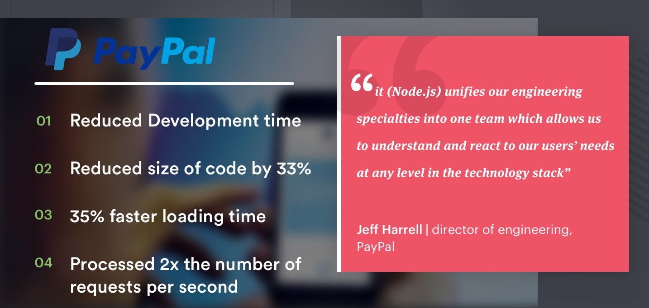
What paypal says ?

Slide 29
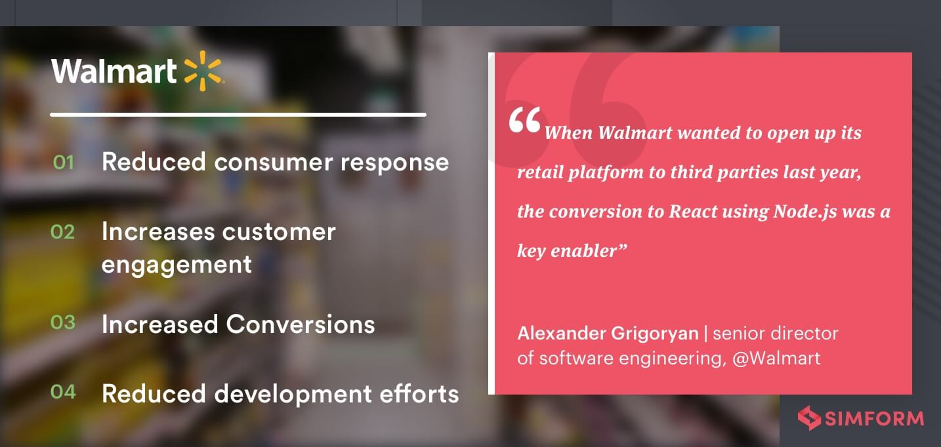
What walmart says ?

Slide 30
History of node.js
Believe it or not, Node.js is only 14 years old.
In comparison, JavaScript is 26 years old and the Web is 33 years old.
14 years isn't a very long time in tech, but Node.js seems to have been around forever.

Slide 31

History of node.js
Node.js was developed by Ryan Dahl and was launched on May 27, 2009 .

Slide 32
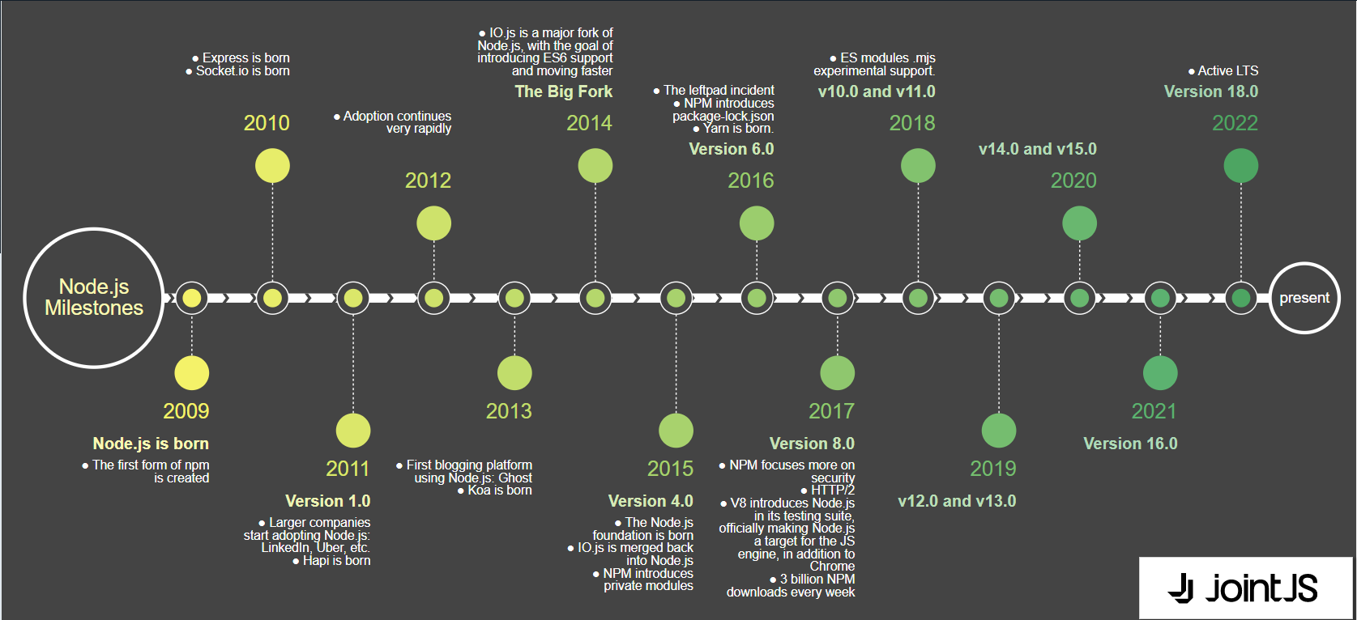
Node.js timeline

Slide 33
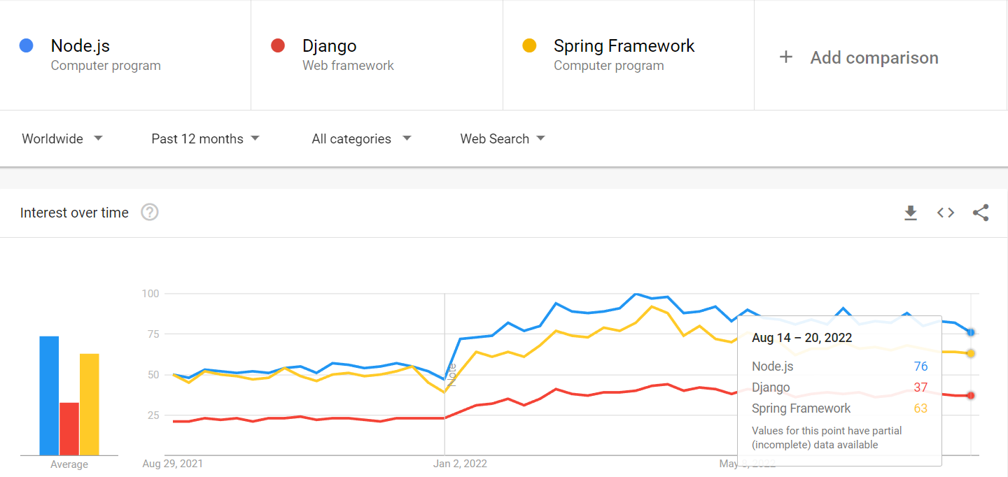
Popularity of node.js

Slide 34

Fee Structure

